Slide 1

Event Processing Course
Contexts
(relates to chapters 7)

Slide 2
Lecture Outline
The notion of context
Context in Building Block
Context dimensions
Composite contexts
Context in practice
Architectural issues

Slide 3
Real life examples
Temporal context
  At daytime we drive with the lights off, while in nighttime we turn them on
Location-related context
  We walk around freely in our own city, but carry around GPS so as not to get lost on a trip abroad
External state such as the weather conditions
  The speed and the style of driving might depend on whether or not it is currently raining

Slide 4
Software Architecture in the Context of History
(Gartner)
Agility of Enterprise IT
Era of Context
Era of the Mainframe
Era of the Server
Era of the Web
CoDA
Advanced SOA
SOA
Three-tier
Two-tier
OLTP
XTP
CEP
Presence
Mobility
Web 2.0
Social computing
Batch
Web
Web Services
Multi-channel
S/360
SNA
PC
LAN
Server
Internet
Mainframe
1960s
1970s
1980s
1990s
2000s
2010s
2020s
Time
Advanced SOA = event-driven SOA
CoDA = Context-driven Architecture
Notes:
Strategic Imperative: Proceed with gradual adoption of service-oriented architecture (SOA) and event-driven architecture (EDA) as fundamental steps in the software industry evolution to greater agility, intelligence and relevance.
Service-oriented architecture arrived on the scene on the coattails of the maturing predecessor: three-tier architecture. In fact SOA, is a special, enriched, case of three-tier architecture. The most developed users of three-tier principles discovered SOA often ahead of the rest of the industry. Similarly, the most mature users of SOA have already discovered event-driven (advanced) SOA, ahead of the mainstream adoption of event processing and event-driven architecture (EDA). While not all architectures arrive as an extension of the previous model, all follow the three stages of evolution: slow leading-edge-only start, rapid industry growth and slow long-tail plateau of mainstream use. Leading edge start occurs while other architectural patterns - occupy the mainstream users. At the plateau stage – a new architectural pattern is typically already emerging in the leading edge practices. While SOA is reaching maturity and is likely to stabilize into the mainstream plateau in the next three years, event processing is nearing the transition form the leading edge architecture to the industry surge. Meanwhile the leading edge is already experimenting with context-aware computing and the first manifestations of an architecture (context-driven architecture, CoDA) are appearing as proprietary implementations. The differentiation that is offered by the creative use of context is so significant that most of the context processing techniques, algorithms and infrastructure solutions are not only proprietary, but secret, protected as a valuable trade asset by the business – an indication of both the early stage of the architecture and its high anticipated impact on the industry.

Slide 5
Context-aware Computing for Context-based Intelligence
Data stores
Context
(indirect relevant information)
Events
Input
(Direct imperative information)
Service
Logs
Queues
Sensors
Services
Web feeds
Notes:
Human decision making is always contextual, but software is rarely so. Most services in SOA in fact are required to apply their business logic consistently across all invocations, using only the direct input as the argument. Using other inputs is considered to break the service encapsulation. This requirement of course is only theoretical because most services do retrieve additional information from databases and other sources and that information definitely influences the ultimate output of the ser vice. In fact some of this additional information is in fact – context. Context is indirectly relevant information, that is information that us useful to functioning of the service, but not provided to the service as part of its invocation. The retrieval of context in the code of the service can be most powerful as the code inside the service can analyze and apply the context in a very fine-grained manner. However it is also most inflexible since the binding (choice) of the types of context happens very early – at programming time. The modern sources of context used in some social computing systems (Facebook) and in mobile systems using GPS location reports, for example – can come from sensors, event brokers, social interaction logs, web feeds and other sources. Systems capable of adding new sources of context and new types of context to those that they are able to recognize possess greater intelligence and are the most valuable to users.
Tactical Guideline: Context will emerge as the highly-volatile type of information that enriches the functioning of a service or an event handler in advanced SOA. Look for opportunities to discover and apply context-awareness to your software systems.

Slide 6





Context as “behavior selection”
Temporal + semantic
Context
Spatial + temporal + state-oriented context
Spatial Context
State-oriented Context
Semantic
Context
In some countries I carry money in my wallet, in other countries I hide the money under my clothes
If I am getting a request from an important person I re-arrange my priorities to handle it first (otherwise I put it in a queue)
A Jewish person who observes the religious laws does not eat diary food within six hours from the time of eating meat
I need to get to a certain address in Sidney using public transportation, I am looking for fastest way (train, bus, boat)
When the radio tells me about a traffic jam in the highway I take an alternative route

Slide 7




In general:
Request
Determine Context
Select
Service
Requester is now in location Y; no car; has daily ticket for all public transport; it is rush hour
Take me to address X
Use time schedules

Slide 8
Context applications
Telco
  Location based services for mobile phones
Social Computing
  Google bases its advertisement business model on user’s context
  Amazon bases its B2C E-commerce on user’s context
  LinkedIn bases its hiring support on user’s context
  Facebook bases its service offering on user’s context

Slide 9
Roles of contexts in event processing
There are three main uses of context by event processing applications:
Partition event stream
Group events together
Determine EPA activity.

Slide 10

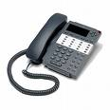

In Event Processing – Context-Based Routing
ECA – Event – Context – Agent:
When event occurs
Determine the open contexts (or open new context)
Route the event to
the context-driven agent
Example: If there is a third call from platinum customer within the same day - notify “angry customers officer”.
Context: John Galt January 11,2008
Identify Customer
Filter out if no platinum customer
If there is an open context for that customer – open with agent “detect angry customer”
Route the event to the agent within the customer context
I’m the second request
Phone request arrives
Angry customer detection agent

Slide 11
Context
A context is a named specification of conditions that groups event instances
so that they can be processed in a related way. It assigns each event instance
to one or more context partitions. A context may have one or more context
dimensions and can give rise to one or more context partitions.
A context may have one or more context dimensions and consist of one or more context partitions.
Context dimensions:
  Temporal
  Spatial
  State-oriented
  Segmentation oriented

Slide 12
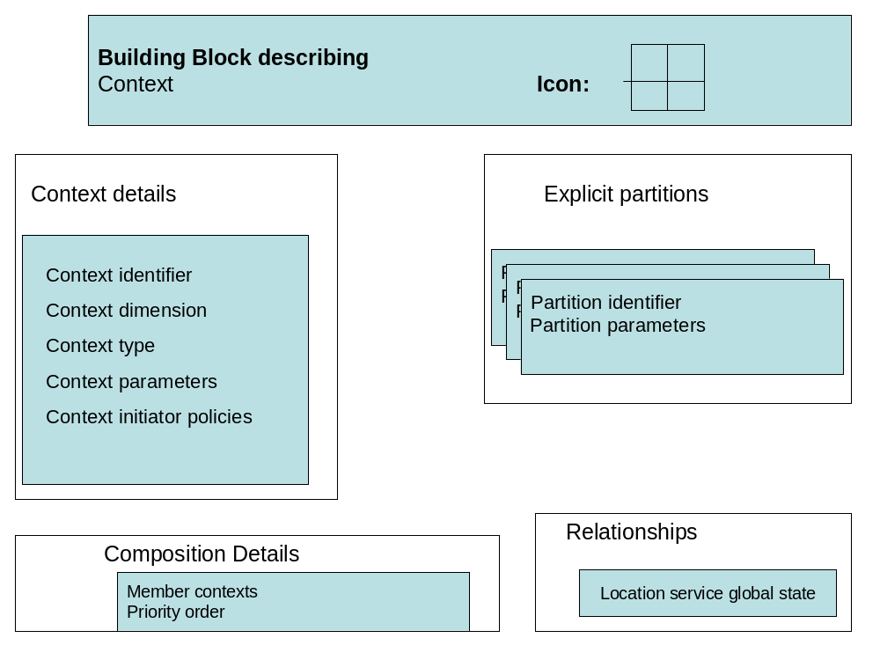
The context building block

Slide 13
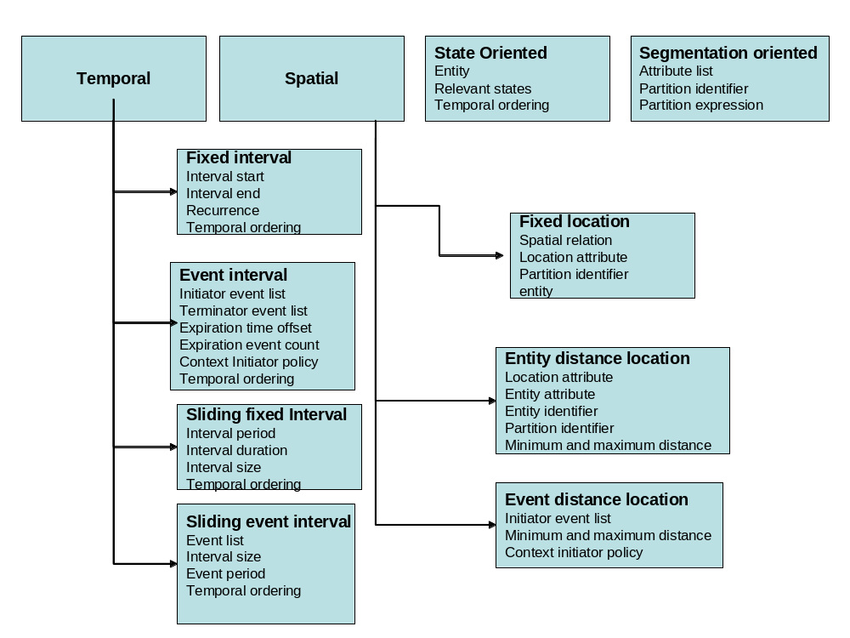
Context dimensions

Slide 14
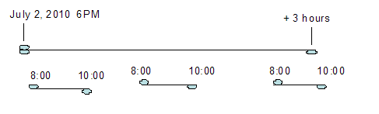
Temporal contexts – Fixed interval
In a fixed interval context each window is an interval that has a fixed time length; there may be just one window or a periodically repeating sequence of windows
Fixed interval
Interval start
Interval end
Recurrence
Temporal ordering

Slide 15

Temporal contexts – Event interval
In an event interval context each window is an interval that starts when the associated EPA receives an event that satisfies a specified predicate. It ends when it receives an event that satisfies a second predicate, or when a given period has elapsed.
Event interval
Initiator event list
Terminator event list
Expiration time offset
Expiration event count
Context Initiator policy
Temporal ordering

Slide 16
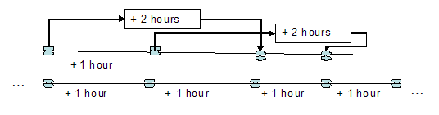
Temporal contexts – Sliding fixed interval
In a sliding fixed interval context each window is an interval with fixed temporal size or fixed number of events. New windows are opened at regular intervals relative to one another.
Sliding fixed Interval
Interval period
Interval duration
Interval size
Temporal ordering

Slide 17

Temporal contexts – Sliding event interval
A sliding event interval is an interval of fixed size that continuously slides on the time axis
Sliding event interval
Event list
Interval size
Event period
Temporal ordering

Slide 18


Context Initiator Policies
Within three days of an volcano eruption (initiator event = earthquake, expiration time offset = + 3 days).
A context initiator policy is a semantic abstraction that defines
the behavior required when a window has been opened and a subsequent initiator event is detected.
The possible policies are: open another window, ignore the new initiator event, refresh the window, or extend the window.
March 5, 2010 10:00
March 7, 2010 06:00

Slide 19
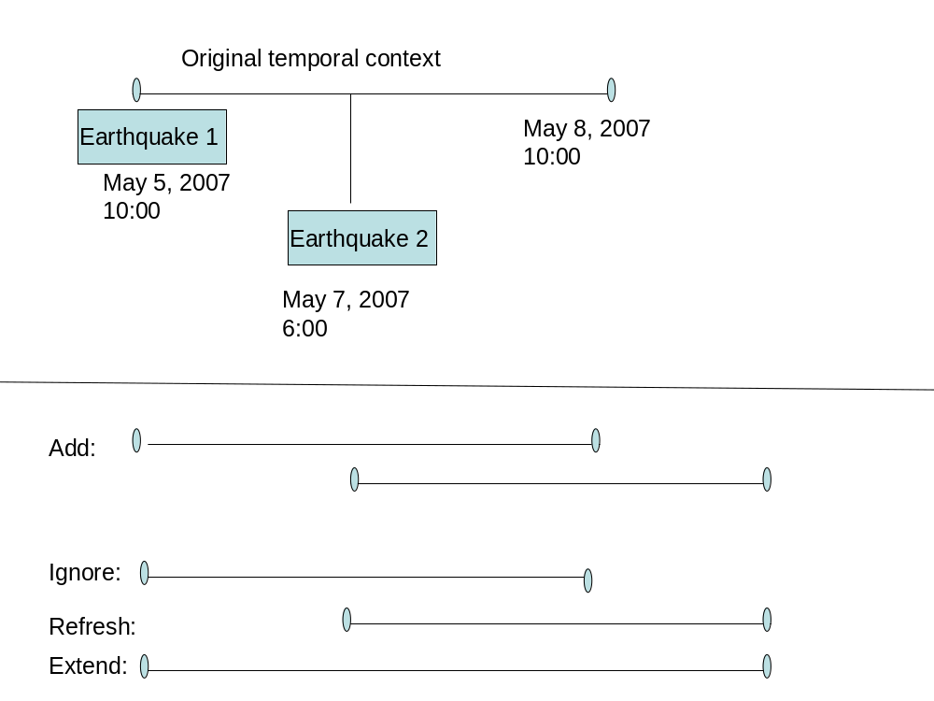
Context initiator policies
Add—A new window is opened, alongside the existing one. In the earthquake example, another window will be added with the interval [May 7, 06:00, May 10, 06:00), while the original window is still open. Relevant events that occur within the intersection of the two intervals will be classified to both context partitions, so if we are monitoring the number of heart attacks within the period of three days from an earthquake in a certain area, we include every heart attack event in both context partitions.
Ignore—The original window is preserved. The new earthquake event does not cause a new window to be opened.
Refresh—The original window is closed and a new window is opened.
Extend—The timeout processing (expiration event count or expiration time offset) is reset to start with the new initiator event. In the earthquake example an expiration time offset is being used, so the window is extended to May 10, 06:00.

Slide 20
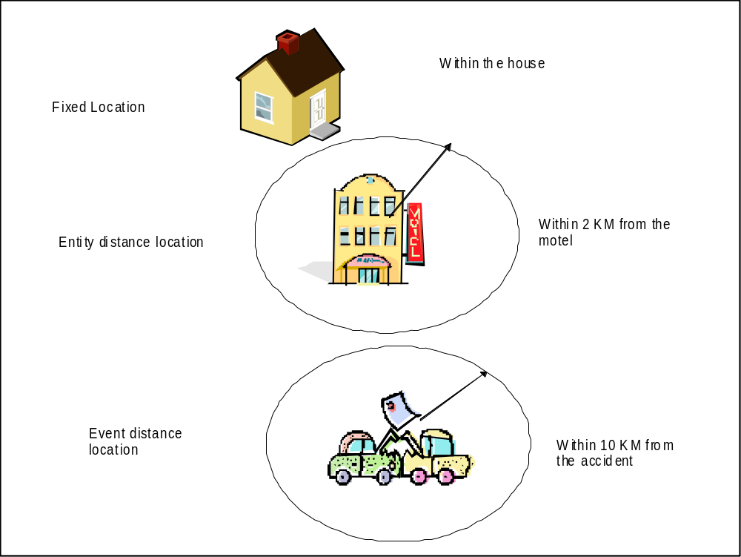
Spatial context

Slide 21
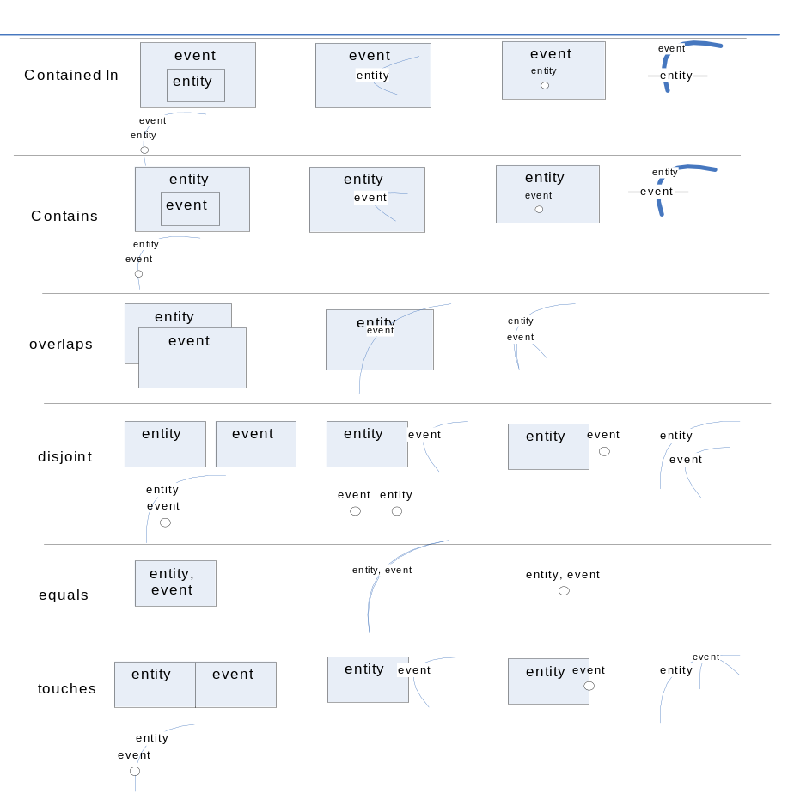
Fixed location
A fixed location context has predefined context partitions based on specific spatial entities. An event is included in a partition if its location attribute indicates that it is correlated with the partition’s spatial entity.
Fixed location
Spatial relation
Location attribute
Partition identifier
entity

Slide 22
Entity Distance Location
An entity distance location context assigns events to context partitions based on their distance from a given entity. This entity is either specified by an event attribute or is given as part of the context specification
Entity distance location
Location attribute
Entity attribute
Entity identifier
Partition identifier
Minimum and maximum distance

Slide 23
Event distance location
An event distance location context assigns events to context partitions based on their distance from the location of the event that triggered the creation of the partition.
Event distance location
Initiator event list
Minimum and maximum distance
Context initiator policy

Slide 24
State oriented context
A state-oriented context has a single partition. It is controlled by an external entity, and the decision on whether to include an event in the partition is based on the state of an external entity at the time when the event occurs or is detected.
  An airport security system could have a threat level status taking values green, blue, yellow, orange, or red. Some events may need to be monitored only when the threat level is orange or above, while other events may be processed differently in different threat levels.
  Traffic in a certain highway has several status values: traffic flowing, traffic slow, traffic stationary. Some events are monitored only during traffic jams in order to reroute vehicles or alert people to expect late arrivals
State Oriented
Entity
Relevant states
Temporal ordering

Slide 25
Segmentation oriented context
A segmentation-oriented context assigns events to context partitions based on the values of one or more event attributes, either using the value of these attribute(s) to pick a partition directly, or using predicate expressions to define context partition membership.
  Segmentation by CustomerId (unrestricted number of partitions)
  Segmentation by different age ranges. We define an explicit partition for each range, for example:
      age < 21
      age ≥ 30 and age < 50
      age ≥ 50 and age < 67
      age ≥ 67
Segmentation oriented
Attribute list
Partition identifier
Partition expression

Slide 26
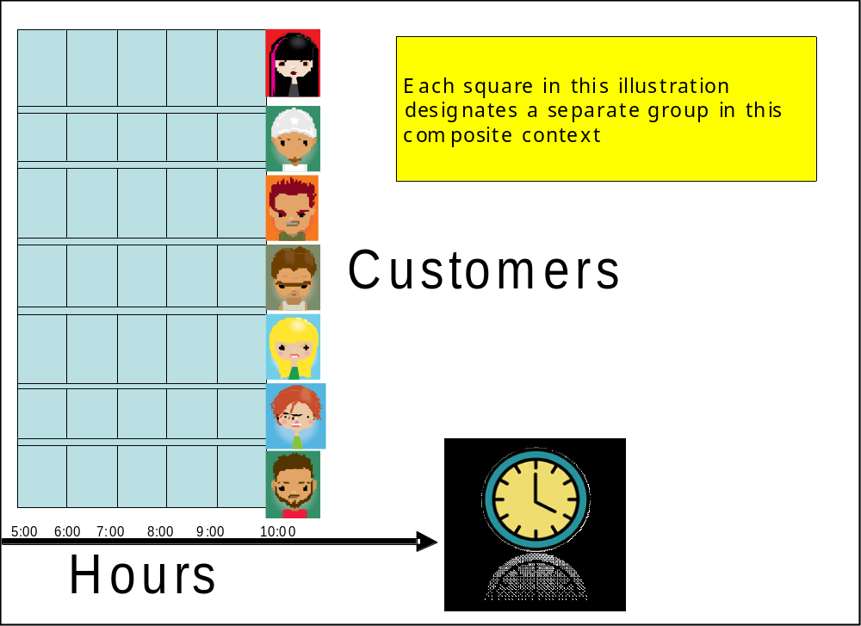
Composite context
A composite context is a context that is composed from two or more contexts. The set of context partitions for the composite context is the Cartesian product of the partition sets of its constituent contexts.

Slide 27
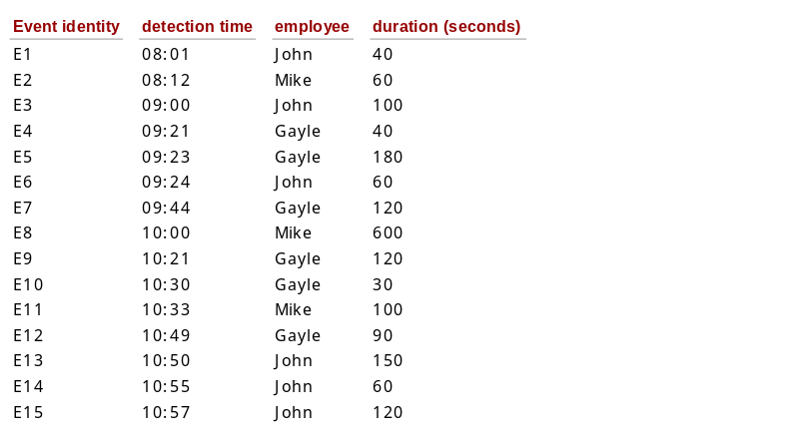
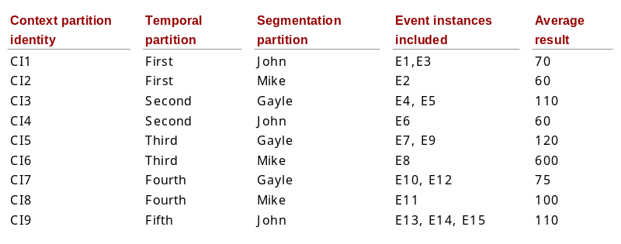
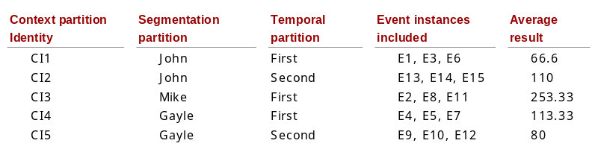
Priority in composite contexts
COMPOSITE CONTEXT
sliding event interval with event period = 3 and interval size = 3
Segmentation by employee
Aggregator finding average duration
Temporal first
Segmentation first
RAW EVENTS

Slide 28
Context in practice - Streambase StreamSQL
CREATE WINDOW tenSecondsInterval(
SIZE 10 ADVANCE 1 {TIME
);
Sliding fixed interval
CREATE WINDOW eventsInterval (
SIZE 10 ADVANCE 1 {TUPLE} TIMEOUT 20
);
Sliding event interval

Slide 29
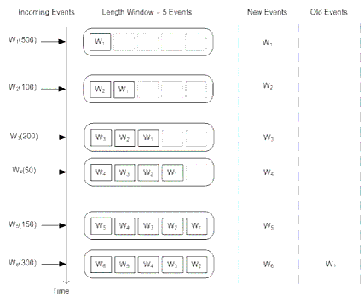
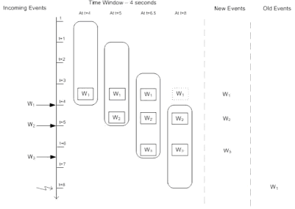
Context in practice – Oracle EPL
SELECT * FROM Withdrawal RETAIN 5 EVENTS
SELECT * FROM Withdrawal RETAIN 4 SECONDS

Slide 30
Context in practice – CCL
CREATE WINDOW Book_w SCHEMA Book_t KEEP ALL;
INSERT INTO Book_w
SELECT * FROM Book_s;
The KEEP policy specifies the kind of window. Here are some examples (there are others):
KEEP LAST PER Id
KEEP 3 MINUTES
KEEP EVERY 3 MINUTES
KEEP UNTIL (”MON 17:00:00”)
KEEP 10 ROWS
KEEP LAST ROW
KEEP 10 ROWS PER Symbol

Slide 31
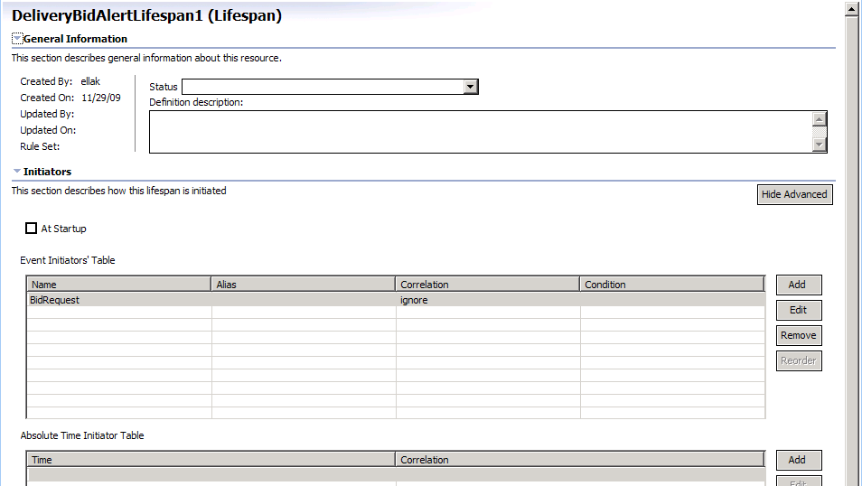
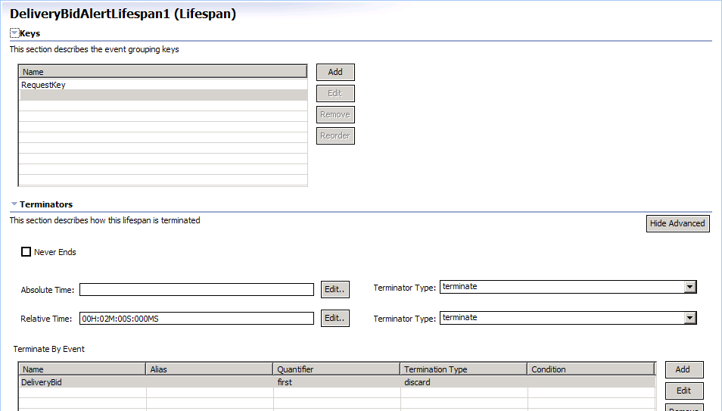
Context in practice – AMiT

Slide 32
Event influencing contexts and context partitions
Event either initiating a new context, or terminating existing context
  Event indicating discount period starts an active context. The context is active either for 3 days, or is terminated upon arrival of event indicating the end of discount period.
  Patient admittance into ER serves as initiator for temporal context, which will be terminated when the patient is discharged.
In segmentation context event can create a new context partition
  An event contains a customer identifier attribute. The value of this attribute can be used to separate events into separate context partition for each customer
event
contexts
context 1
context 2

Slide 33


Context-based routing between EPAs
Choosing an EPA which will perform the processing of the event based on context.
  When the overall security level in airport area is raised to state “YELLOW” (low level security alert) the airport security system is starting tracking whether the amount of failed security checks (security checks raising a security issue) crosses a certain threshold
  During a discount period a company is keeping track of overall purchases amount during this period for future analytics, which is not done at regular time
E1 event
Instance
E1 event
instance
EPA 1
E1
E1
EPA 2
Context
EPA 3

Slide 34
Context-based routing between EPA instances
Choosing an instance of the EPA which will perform the processing according to the context partition associated with this instance. This determines where the event is grouped to, for a stateful operation
  Aggregating customers according to their age; an incoming event is assigned to the instances of EPA by temporal and segmentation context.
  The temporal context is daily, the segmentation context partitions based on attribute indicating age, according to four groups (18-25, 25-35, 35-50, >50).
EPA
EPA 1
E1 event
Instance
EPA 2
EPA instance
Context

Slide 35
Context service within EPN –architectural issues
Local vs. shared context
  Some context is local to a specific EPA
    Segmentation context over some attribute of incoming element – the processing of different segments is done by different EPA instances
    Context initiated/terminated by “local” events (those that EPA subscribes to directly) and interesting only to local EPA instances.
  Some context is external, shared between multiple EPAs and channels
    Channel performing context-based routing between EPAs should have access to context service
    Context shared among multiple EPAs – when one EPA acts as context initiator/terminator for a context which affects over EPAs execution, or multiple EPAs dependent on the same context

Slide 36
Context service within EPN –architectural issues
–cntd.
Centralized vs. distributed topology
  Centralized context service to be shared among all components in EPN
    Logical issues arising due to the fact that the decision on how to process an event is handled at two points – the context service and the EPA but at different time points and different world views
      Race conditions between initiators/terminators being handled by the context service and events influenced by this context arriving earlier at processing EPA
      Correctness issues due to the fact that EPA might see only part of information context service does (due to filtration for example)
    Scalability issues – centralized context having to handle massive processing of contexts for the whole EPN
    Centralized context has to be aware of all existing EPA instances, and either manage or be informed on state changes of those instances, which complicates the EPN management layer

Slide 37
Lecture Summary
The notion of context
Context in Building Block
Context dimensions
Composite contexts
Context in practice
Architectural issues

